Slide 1
Impact of Data Inconsistencies & Tapping Frequency on Information Quality of Chennai’s AVL-based Information System
By-
Siddharth Gupta
Karthik K. Srinivasan
Arun Prakash
Alima Jafreen

Slide 2
Introduction
AVL based information systems, such as the one recently launched in Chennai, are becoming fairly ubiquitous to relay travel information to people
Tapping frequency: Primary parameter in data collection process-
Significant impact on amount of data available
High value: Redundant data
Low value: Lost link traversals
Data transmission and storage costs? Fairly low

Slide 3
Data Inconsistencies in AVL Systems
Satellite based systems susceptible to variety of errors emanating from various sources-
Satellite coverage of subject area
Atmospheric Disturbances
Device Faults
Transmission Errors
Errors have multiple manifestations (delays, faulty values, lags, missing values etc.)
Non-trivial impact on information quality

Slide 4
Data Inconsistencies Under Focus
Delayed data update
Data transmitted continuously
Updated intermittently
Lag in data stream
Time period between transmission from device and access by data center
Analysis can be based on Actual or Access Timestamp
Signal Loss
No triangulation
Transmission losses

Slide 5
Simulation Methodology
1. Tapping Frequency
2. Data Inconsistencies

Slide 6
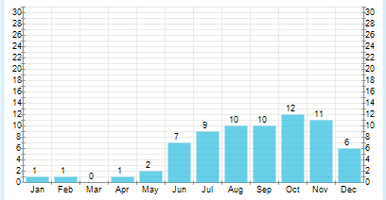
Benchmark
Needed for comparative analysis
Any stretch of data has the mentioned faults
For the benchmark, we can:
Consider maximum available data (Frequency- 9secs)
Minimize atmospheric disturbances-
Benchmark assumed to present ‘true’ picture
Fig.1: Average days with precipitation per Month
1 mm threshold, Average over 1961-1990,
Source: WMO

Slide 7
Tapping Frequency
Highest frequency of location data update
9 seconds
Every n^{th} update utilized to analyze performance with following frequencies-
18, 27, 36, 45, 54, 63, 72, 81, 90 seconds

Slide 8
Delayed Data Update
2 modes of delayed update-
Device updated every n^{th} transmission (n=constant)
Update frequency varies across devices and is stochastic for individual devices
Difference from frequency test-
Observations present but not updated
Levels tested
Constant n: 1, 2, 3, 4, 5
Randomly selected for each device from {1, 2, 3, 4, 5} through time

Slide 9
Lag in Data Stream
Implemented
True timestamps of transmissions are lost
Lagged (access) time used as timestamp
Stream lagged by constant periods of 5, 10 or 15 minutes
Not implemented
Basing extraction on transmitted timestamps available after lag time (as done in the online version)
Modification in offline extraction code:
Process transmissions at access times
Output end-of-processing timestamp to serve as access time for forecasting module

Slide 10
Signal Loss
Device-wise allocation of probability for signal loss:
Discrete ‘p’ set: {0.50 to 1, inclusive, steps of 0.05}
In each transmission, observation for device ‘x’ is processed with probability ‘p(x)’

Slide 11
Impact on Observed Link Traversals (Extraction Module)

Slide 12
Parameters Computed
Number of link traversals
Aggregated
Link-wise
{ Closest matching traversal in benchmark
Based on link and timestamp }
Measure of dissimilarity
Traversal Count
Timestamp
Travel time
Average Speed

Slide 13
Tapping Frequency
Variation of Observation count with tapping frequency

Slide 14
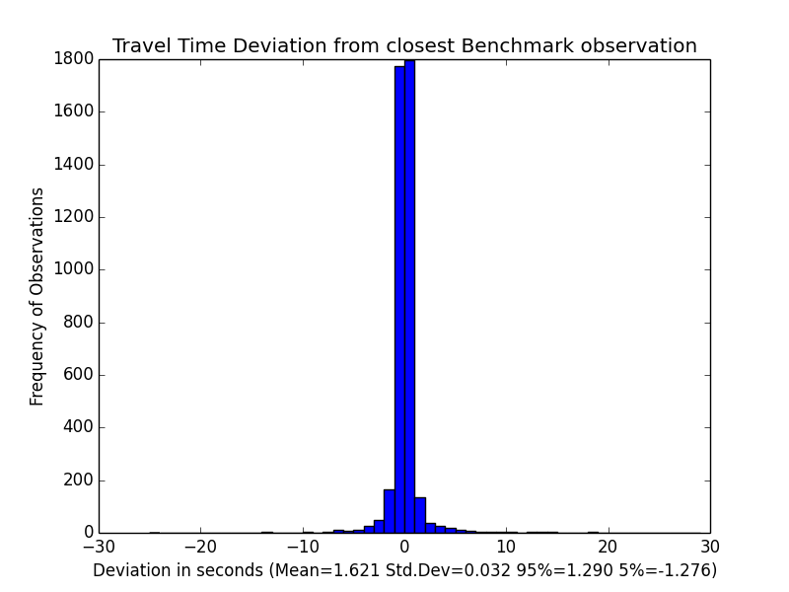
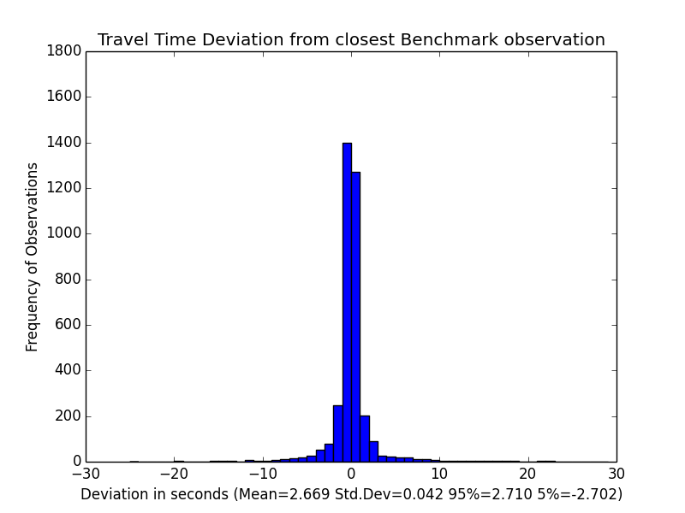
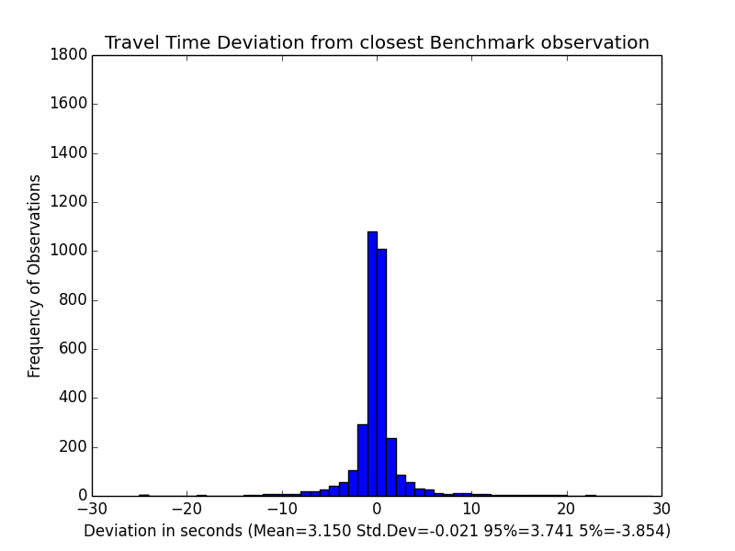
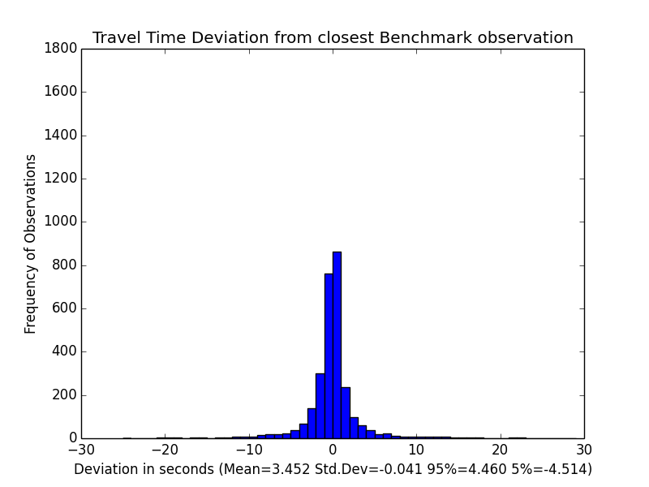
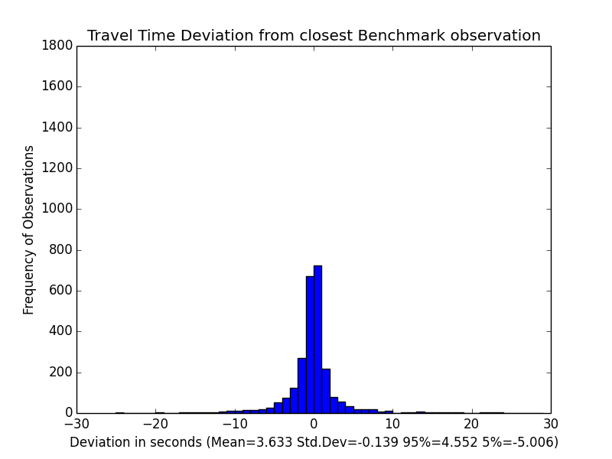
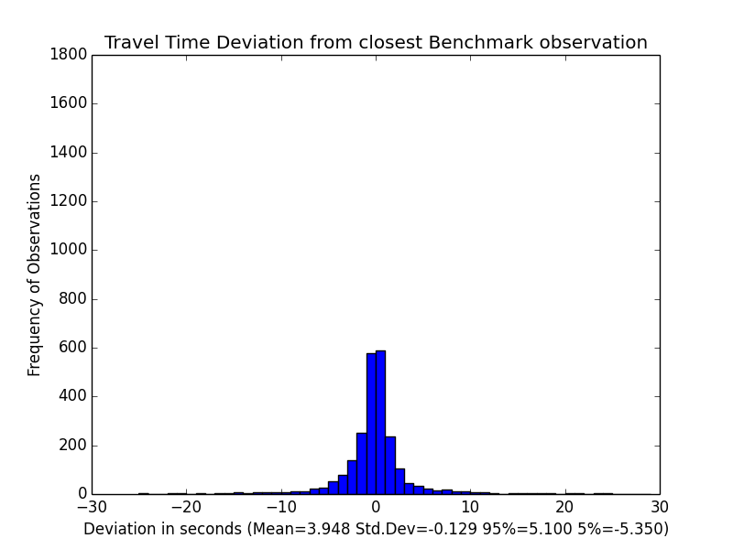
Tapping Frequency- TT deviation from benchmark
18 secs
27 secs
36 secs
45 secs
54 secs
63 secs
Note: Outliers have been filtered
Shown with timestamp analysis

Slide 15
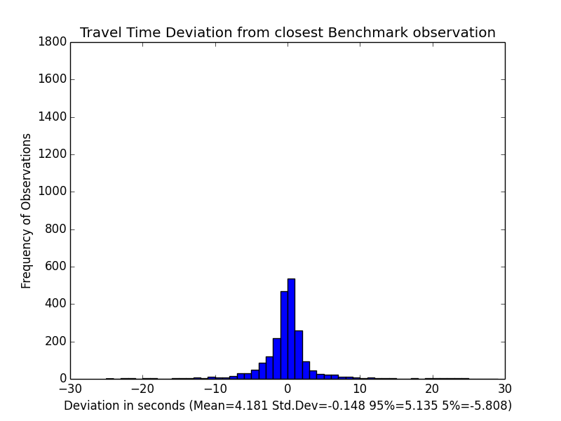
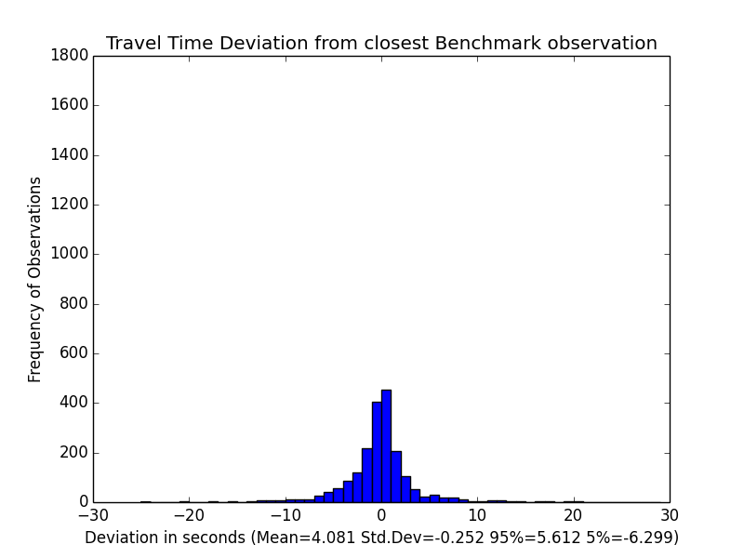
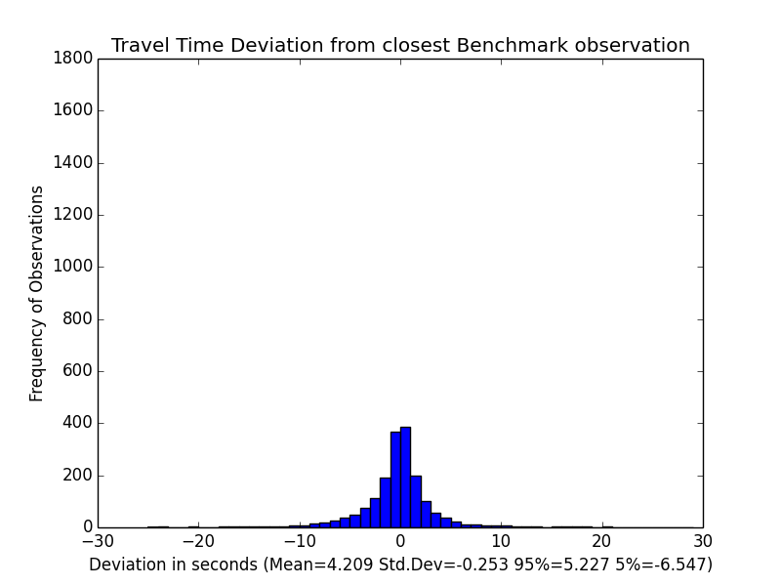
Tapping Frequency- TT deviation from benchmark
72 secs
81 secs
90 secs
Note: Outliers have been filtered
Shown with timestamp analysis

Slide 16
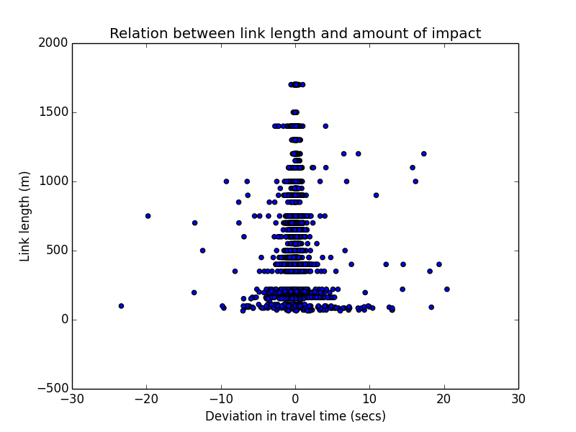
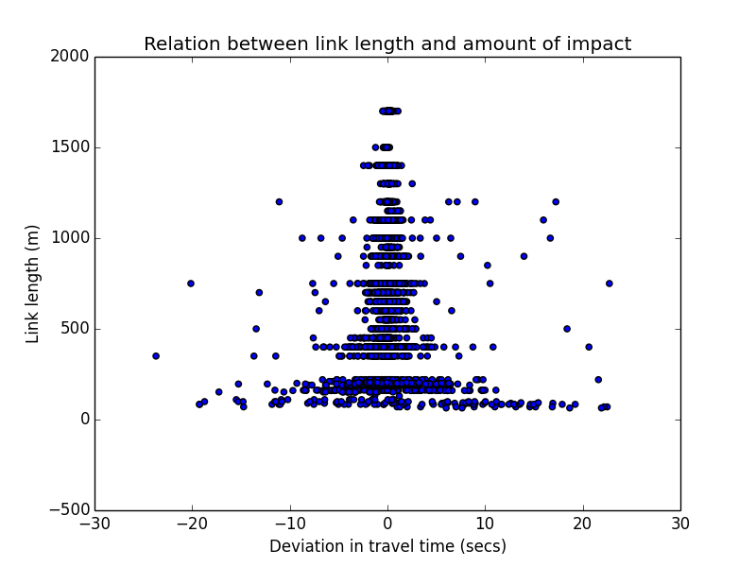
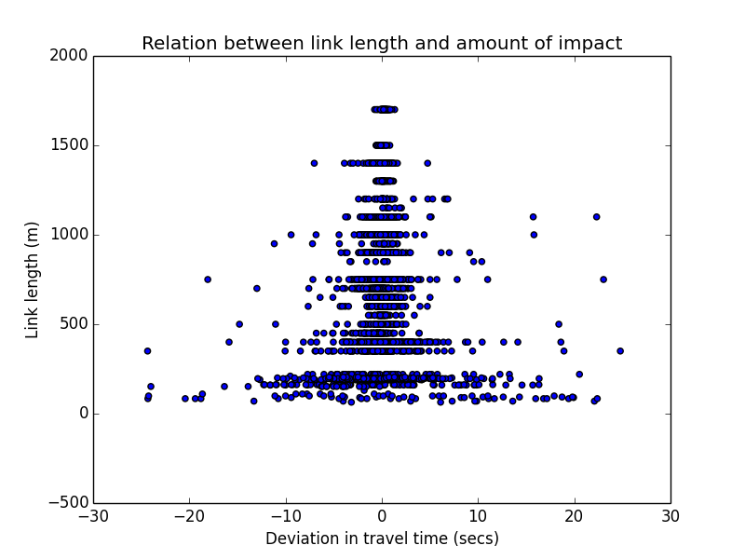
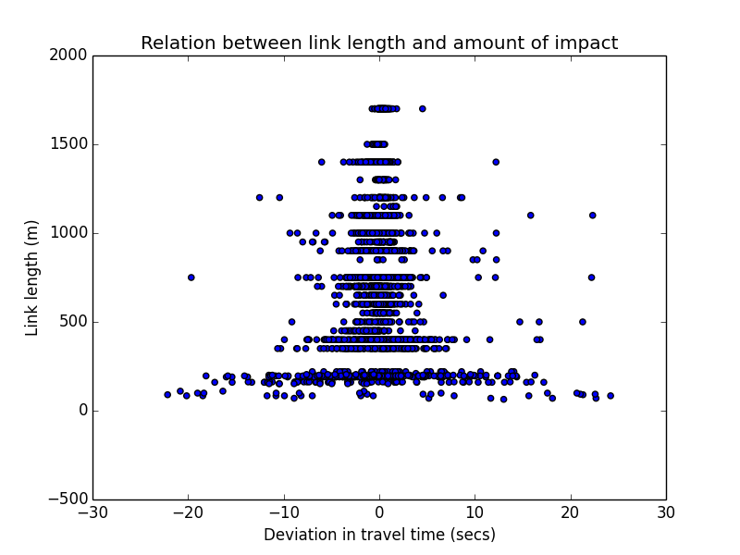
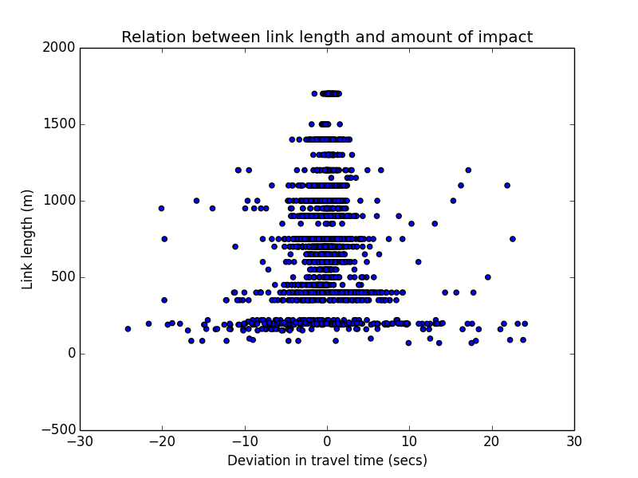
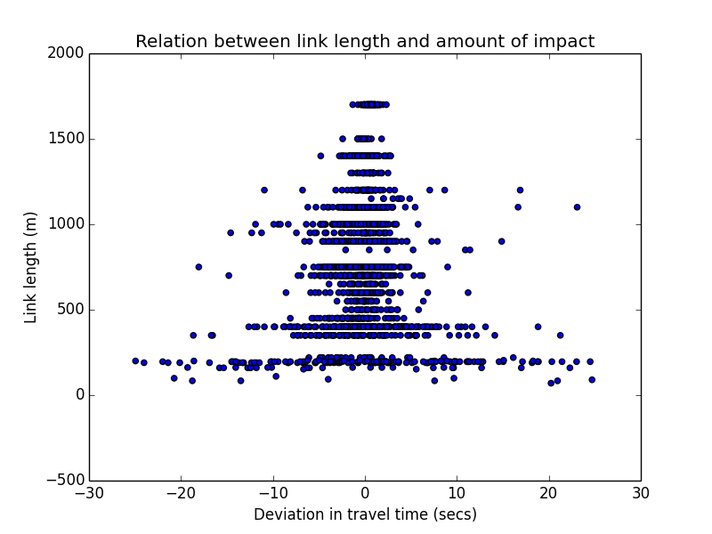
Tapping Frequency- TT deviation from benchmark with Link length
18 secs
27 secs
36 secs
45 secs
54 secs
63 secs
Note: Outliers have been filtered
Shown with timestamp analysis

Slide 17
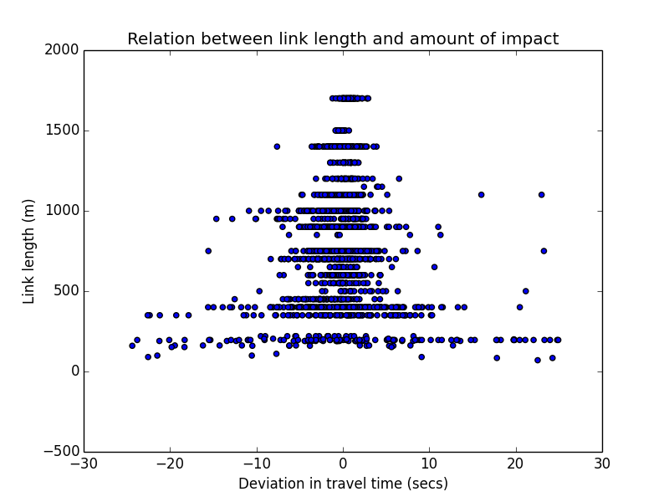
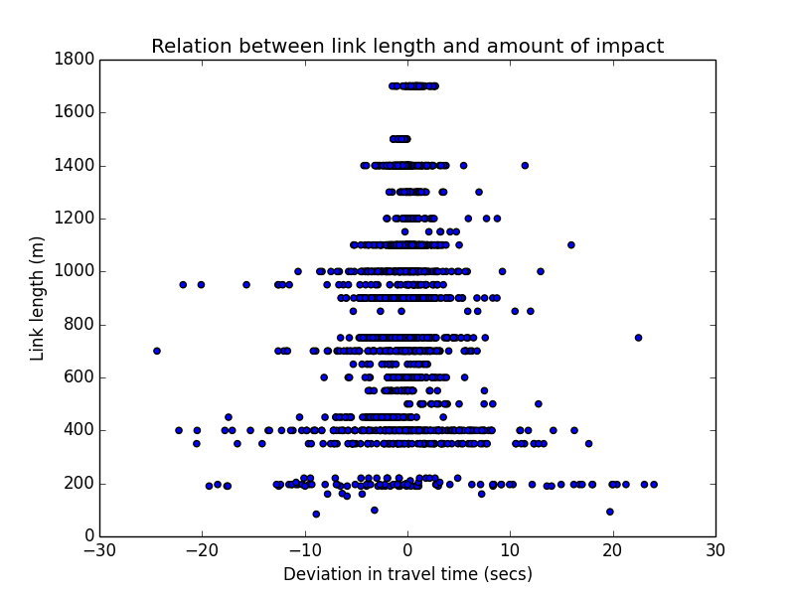
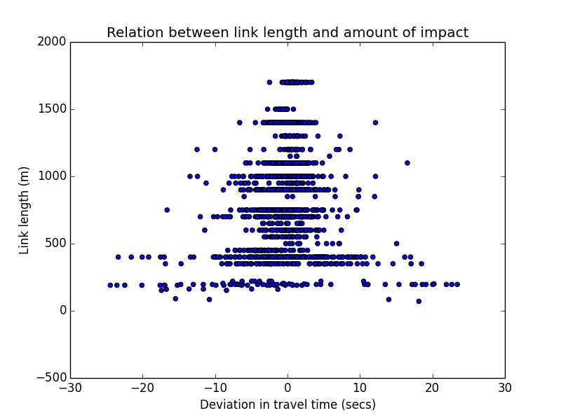
Tapping Frequency- TT deviation from benchmark with Link length
72 secs
81 secs
90 secs
Note: Outliers have been filtered
Shown with timestamp analysis

Slide 18
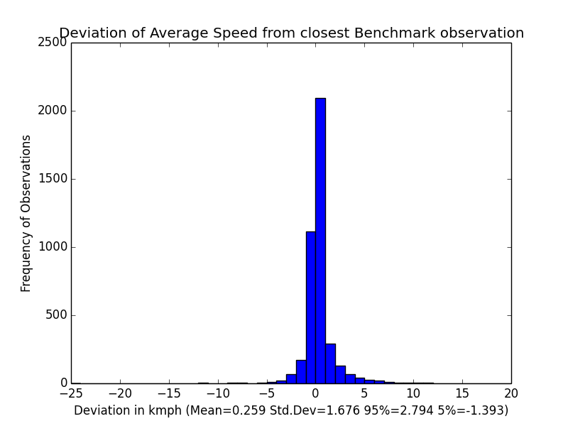
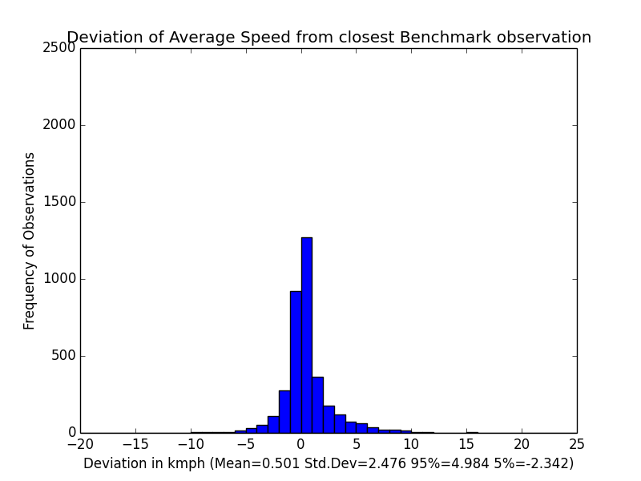
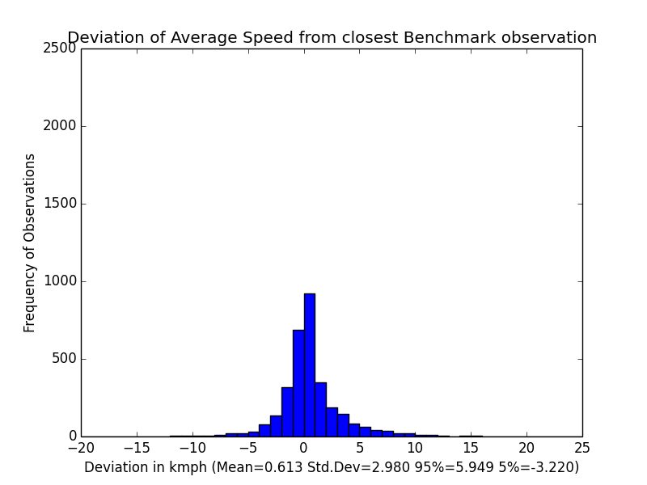
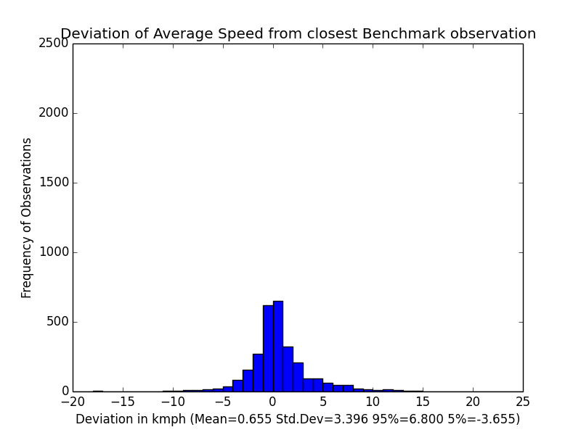
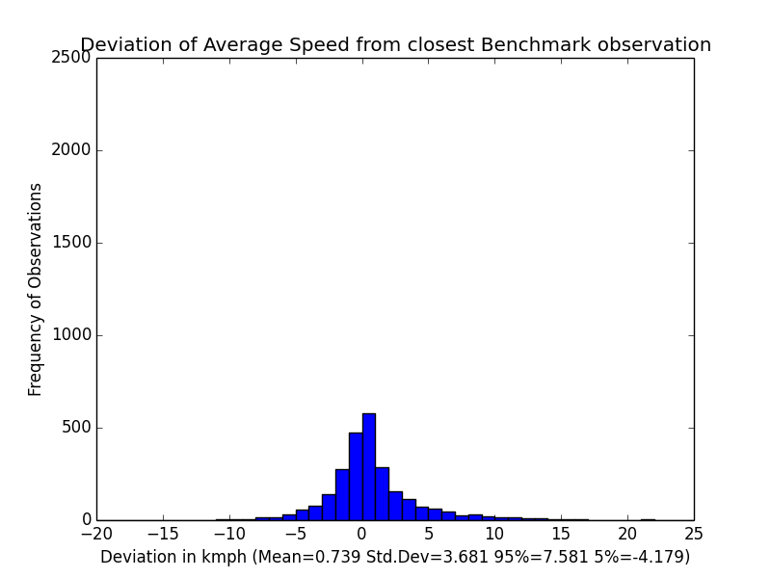
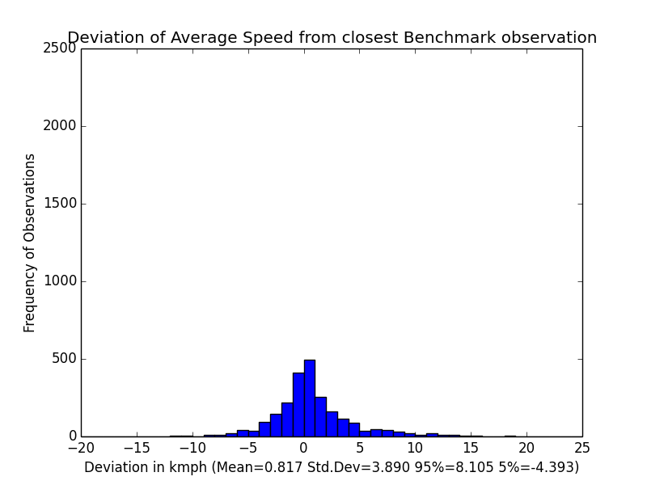
Tapping Frequency: Avg. Speed deviation from benchmark
18 secs
27 secs
36 secs
45 secs
54 secs
63 secs

Slide 19
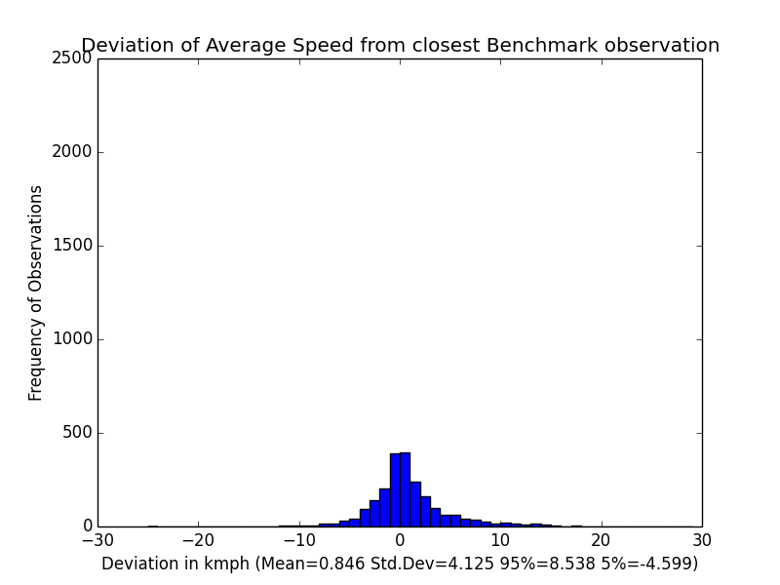
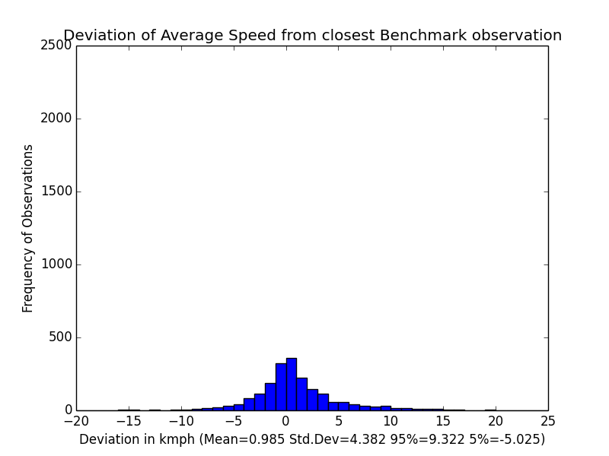
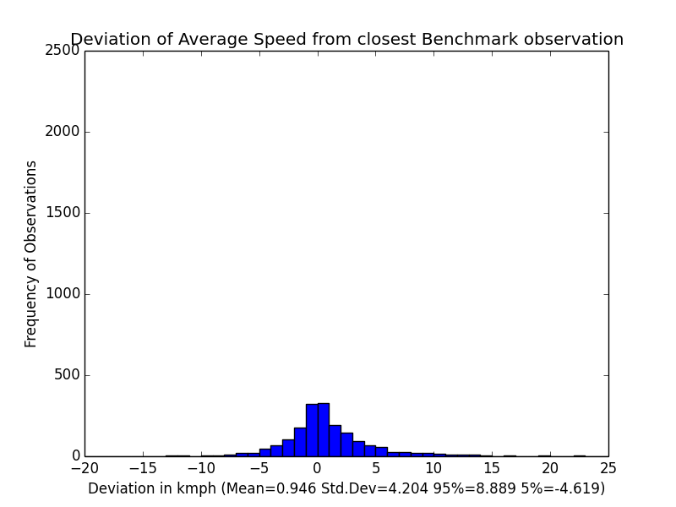
Tapping Frequency: Avg. Speed deviation from benchmark
72 secs
81 secs
90 secs

Slide 20
Tapping Frequency- Variation of SD from benchmark
Variation of TT SD
Variation of Avg. Speed SD

Slide 21
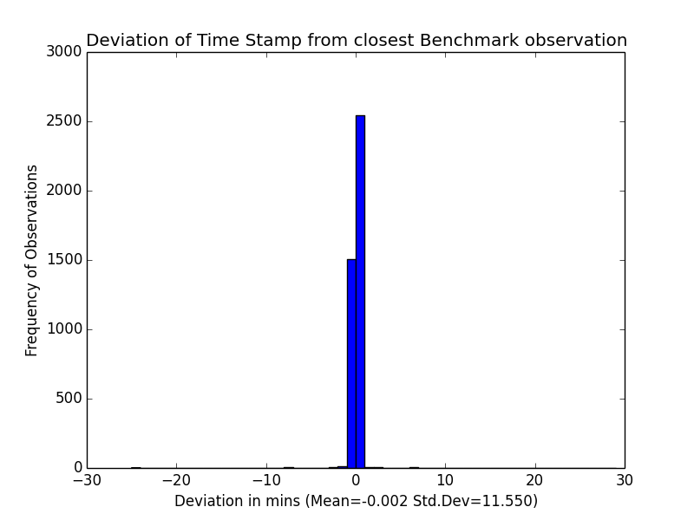
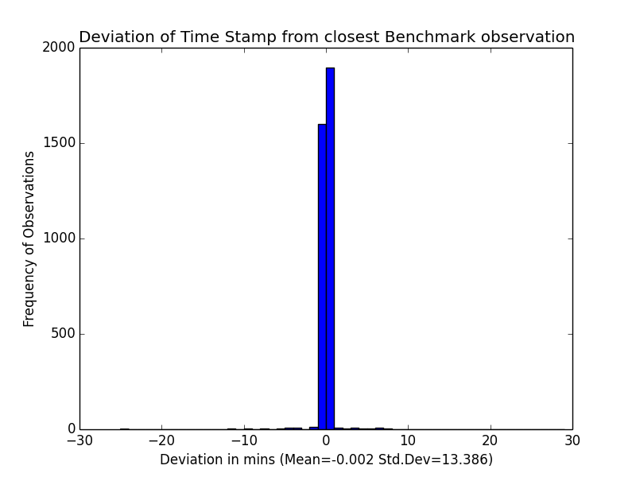
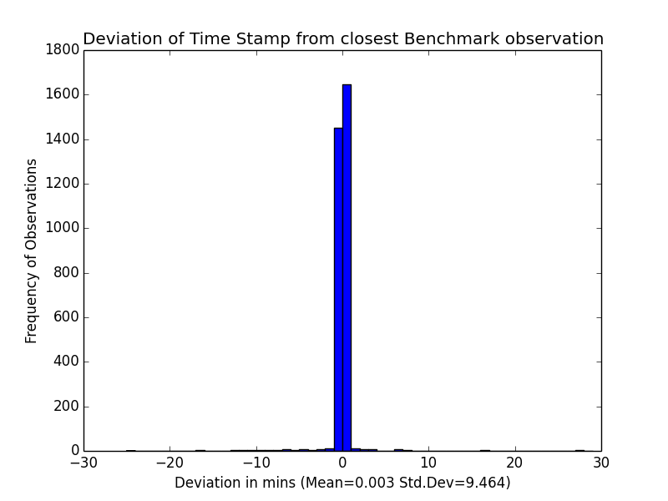
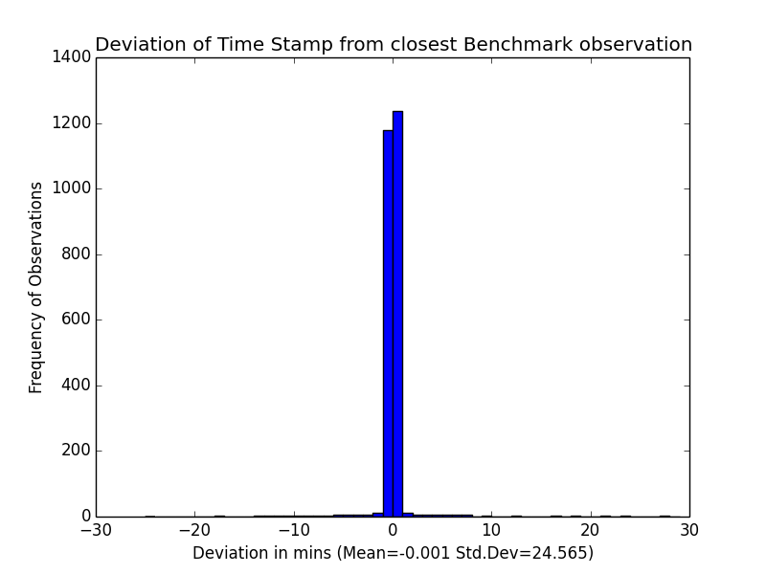
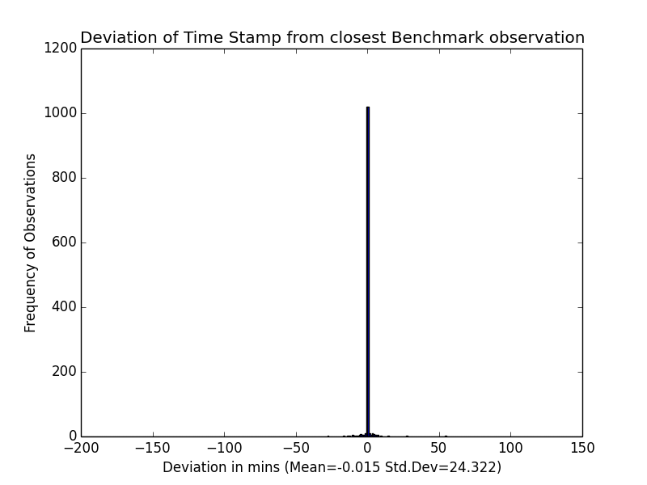
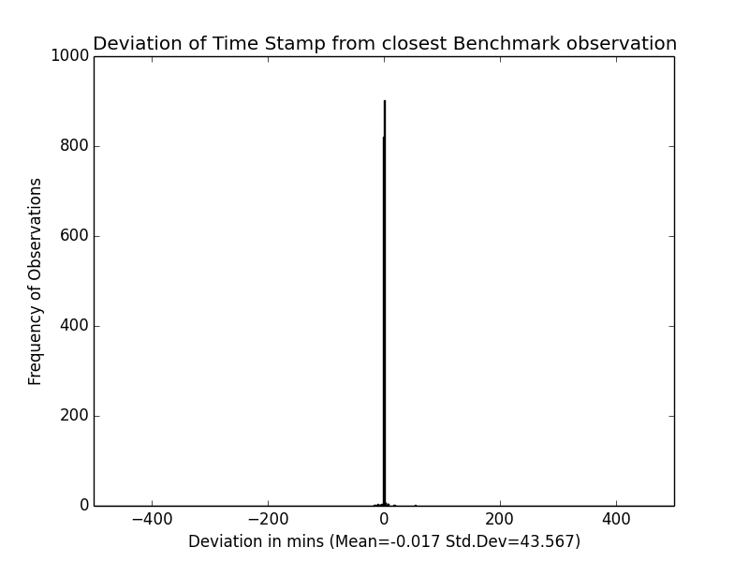
Tapping Frequency: Timestamp deviation from benchmark
18 secs
27 secs
36 secs
54 secs
72 secs
90 secs

Slide 22
Variation of Timestamp SD with frequency

Slide 23
Tapping Frequency- Conclusions
Traversal count decreases with decreasing frequency
Deviations in Average speed and Travel Times seem to be normally distributed with decreasing frequency
The SD for these increases with decreasing frequency
There is no significant change in the timestamp of the readings
The standard deviations for changes in all the three measures increase with decreasing frequency
The analysis encourages the use of the highest available frequency. Intuitively, this would be suggested only till a limiting lower value, beyond which higher frequency would not provide proportional benefits.

Slide 24
Delayed Data Update
Variation of Observation count with delay in data update

Slide 25
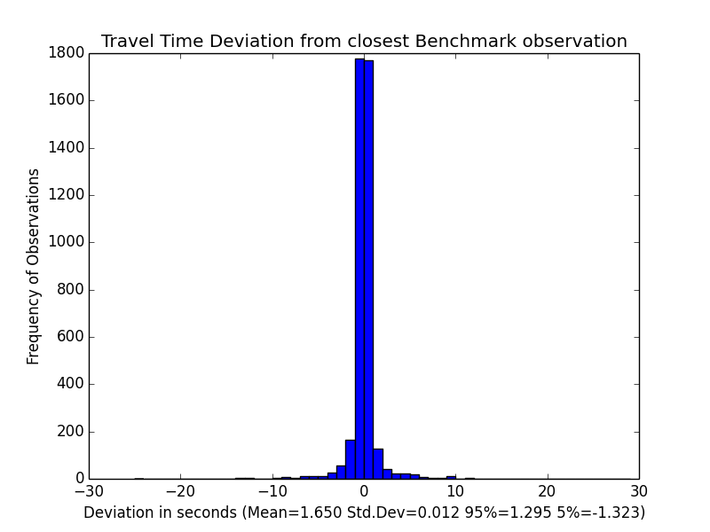

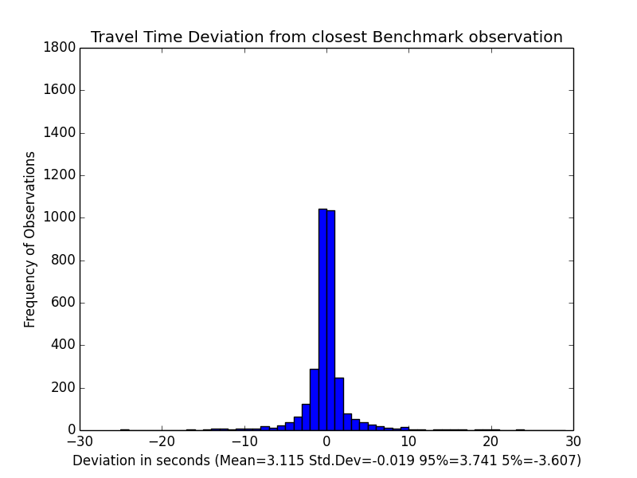
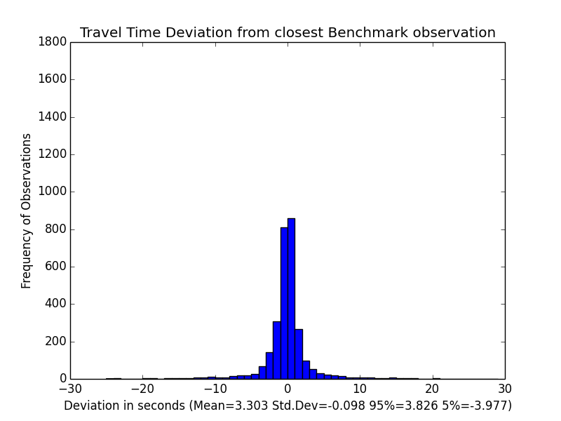


Delayed Data Update- TT deviation from benchmark
Alternate Update
Every 3rd transmission
Every 4th transmission
Every 5th transmission
Every 6th transmission
Random Update

Slide 26

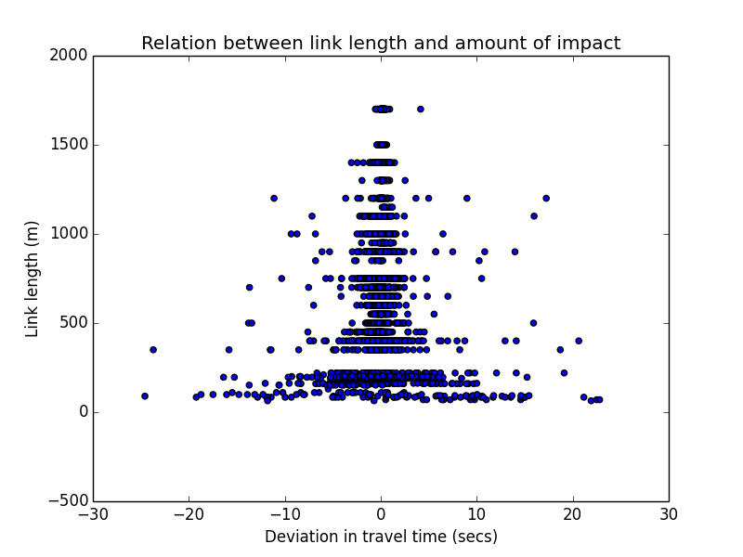
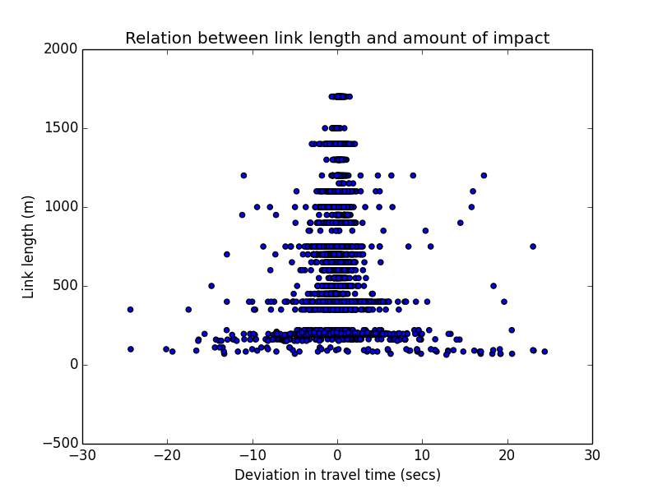
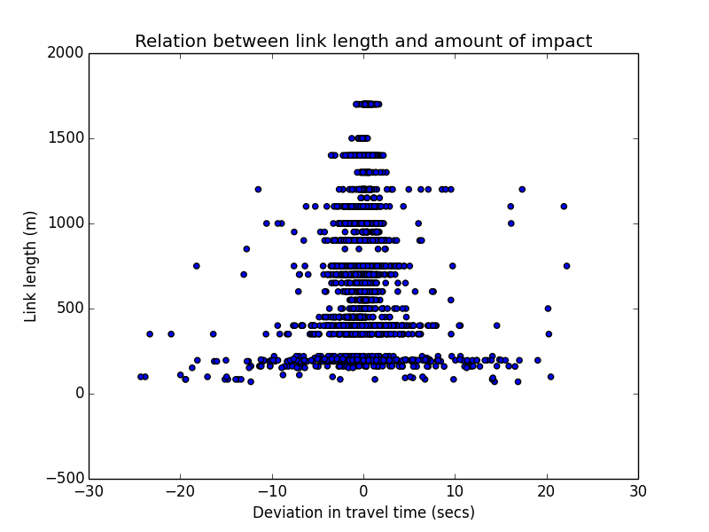
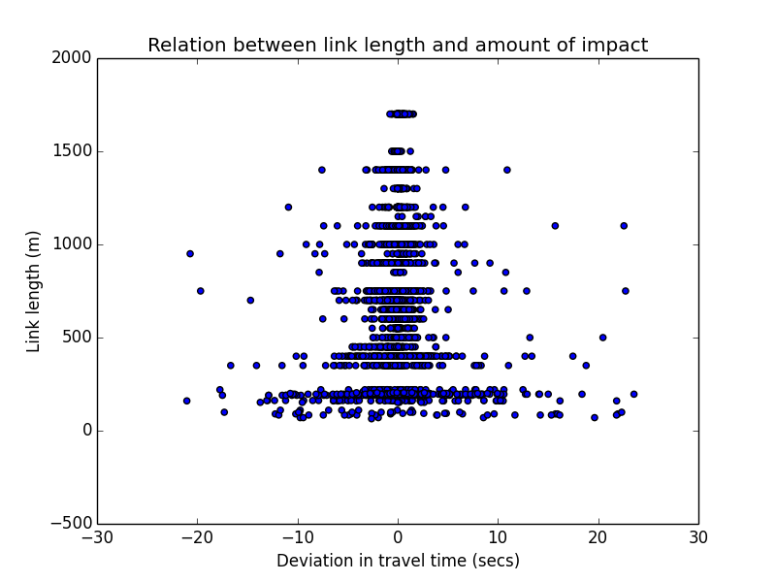
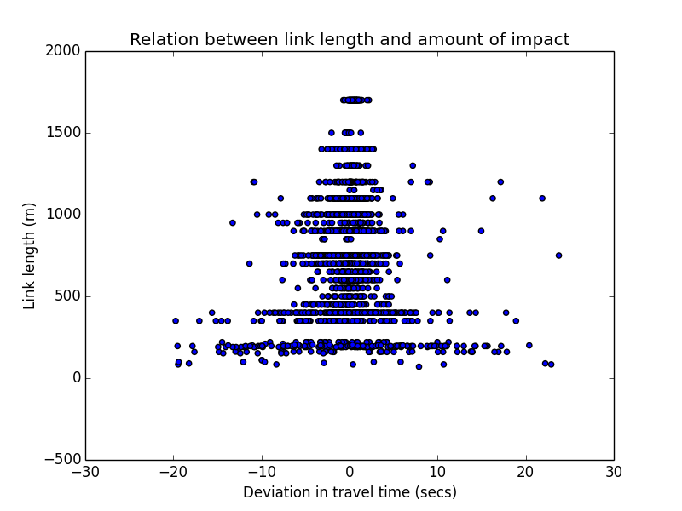
Delayed Data Update- TT deviation from benchmark with Link Length
Alternate Update
Every 3rd transmission
Every 4th transmission
Every 5th transmission
Every 6th transmission
Random Update

Slide 27
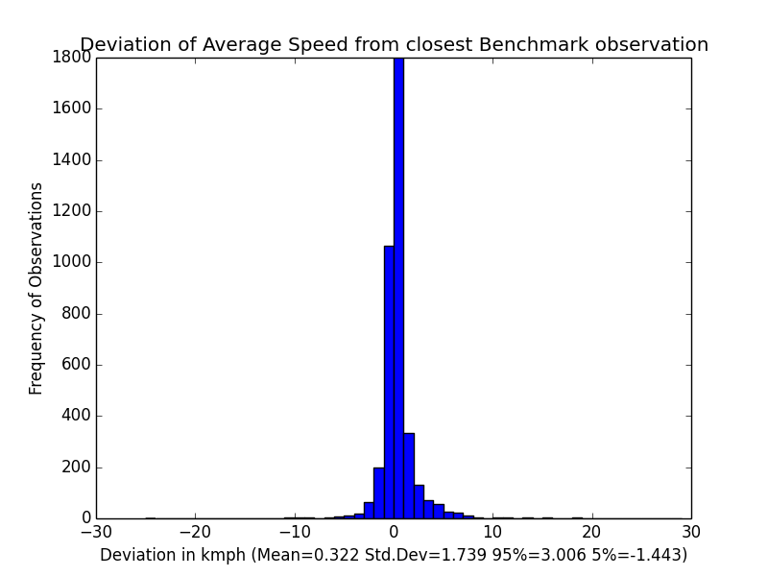
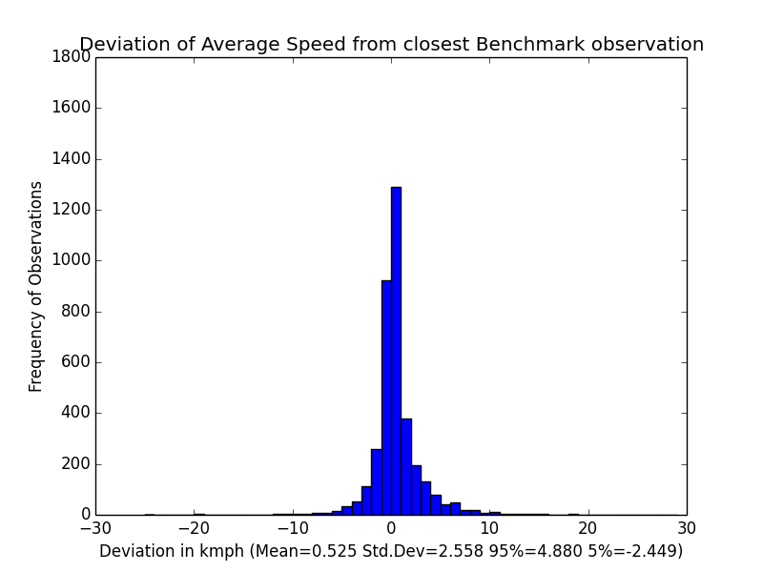
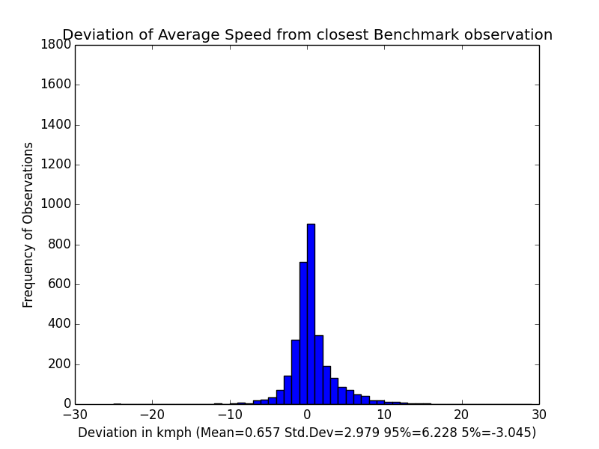
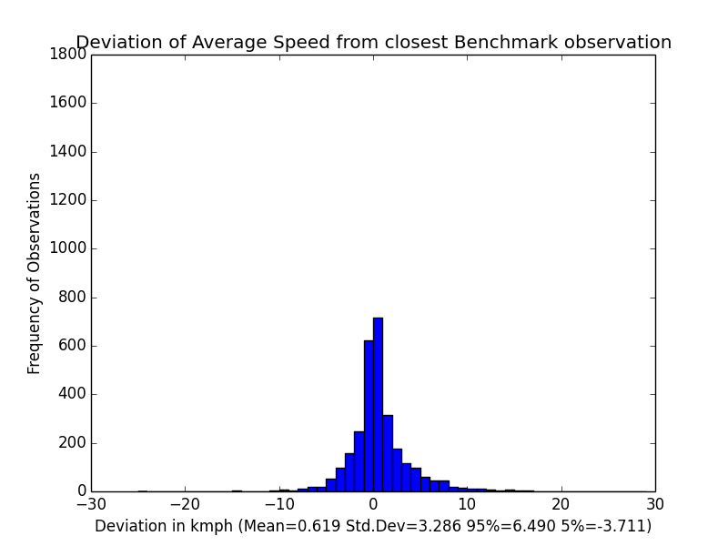
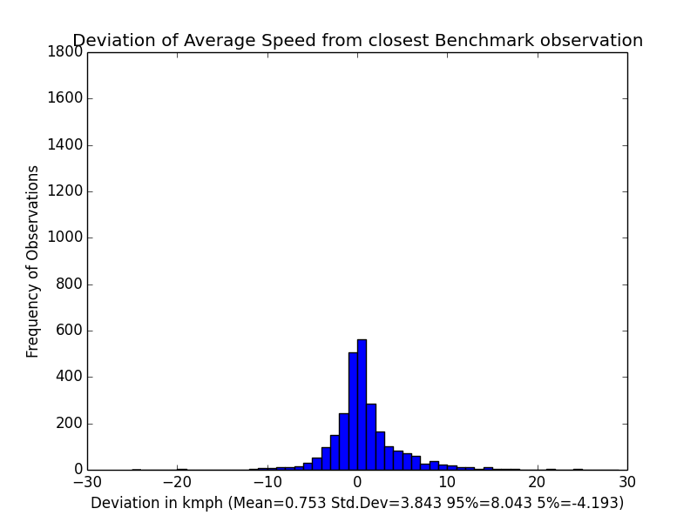

Delayed Data Update: Avg. Speed deviation from benchmark
Alternate Update
Every 3rd transmission
Every 4th transmission
Every 5th transmission
Every 6th transmission
Random Update

Slide 28
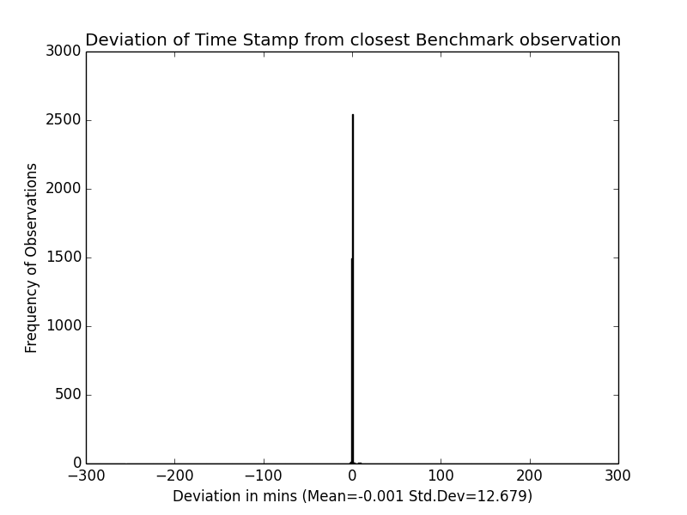
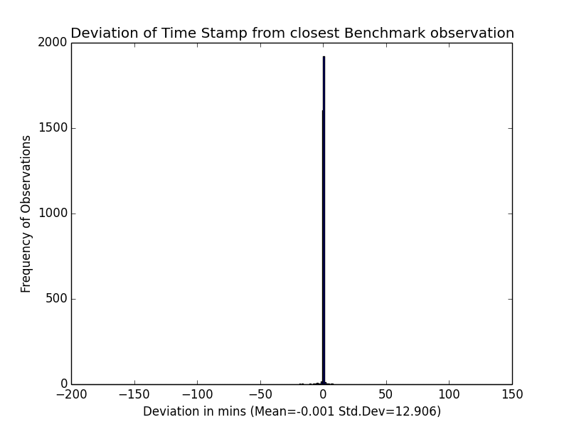
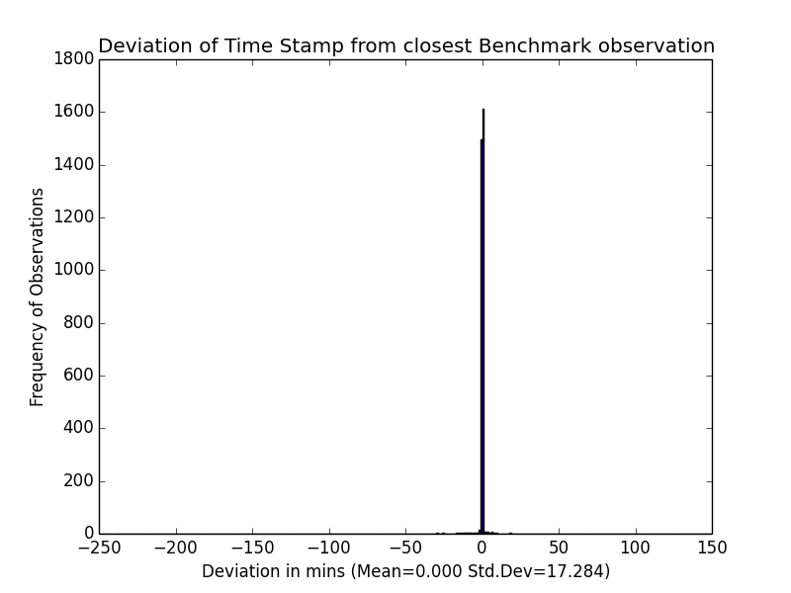



Delayed Data Update
Alternate Update
Every 3rd transmission
Every 4th transmission
Every 5th transmission
Every 6th transmission
Random Update

Slide 29



Lag in Data Stream- deviations from benchmark: No Impact
Timestamp
Speed
Timestamp

Slide 30




Signal Loss
Deviation in Travel Time
Deviation in Avg. Speed
Deviation in timestamp

Slide 31
Impact on Predicted Travel Time (Forecasting Module)

Slide 32
Parameters Computed
Route-wise contributions (%)-
Kalman
Measured
Historic 1 (3min buckets)
Historic 2 (1min interpolated buckets)
Historic 3 (1min buckets- never used since interpolated version has higher priority)
This is always 0 since the interpolated version of the same takes precedence

Slide 33
…contd.
Number of runs
MAPE
Reliability percentages
2 min
3 min
4 min
5 min

Slide 34
Presentation of percentage contributions in prediction results
A typical record looks like-
An observation might or might not require contributions from a particular class of measurement. This does not imply the non-availability of measurements from that class
For eg.- measured observations shall be considered only if Kalman observations are not available.
Analysis strategy-
Percentages can be computed as a percentage of time or length
Hence, we shall end up with link-km or link-hours explained by each prediction class
% Kalman | % Measured | % Historic 1 | % Historic 2 | % Historic 3
21.78 | 14.78 | 48.24 | 15.20 | 0

Slide 35
Tapping Frequency
Number of Kalman Predictions
Notes:
Route-wise results- 1,3,5,6,8

Slide 36


Tapping Frequency

Slide 37

Tapping Frequency

Slide 38


Tapping Frequency

Slide 39


Tapping Frequency

Slide 40


Tapping Frequency

Slide 41


Tapping Frequency

Slide 42


Tapping Frequency

Slide 43
Conclusions: Frequency on Prediction
Counts of available Measurements (from extraction) and Kalman predictions decrease with decreasing frequency
MAPE of overall prediction process not severely impacted due to decreasing tapping frequency
2 min and 3 min reliabilities do seem to fall a bit but 4 min and 5 min reliabilities remain almost the same
% of route runs for which measurements are available falls with frequency
% Kalman is seen to increase
Is measurement tend to 0, Kalman will also tend to 0

Slide 44


Delayed Data Update

Slide 45

Delayed Data Update

Slide 46


Delayed Data Update

Slide 47


Delayed Data Update

Slide 48


Delayed Data Update

Slide 49


Delayed Data Update

Slide 50


Delayed Data Update

Slide 51
Delayed Data Update- Conclusion

Slide 52


Lag in Data Stream

Slide 53

Lag in Data Stream

Slide 54


Lag in Data Stream

Slide 55


Lag in Data Stream

Slide 56


Lag in Data Stream

Slide 57


Lag in Data Stream

Slide 58


Lag in Data Stream

Slide 59
Lag in Data Stream- Conclusion

Slide 60
Signal Loss

Slide 61
Improvements to the analysis

Slide 62
Possible Improvements
Consideration of Access timestamp alongside Actual timestamp for Delayed Data update
Benchmark selection-
More thorough analysis of best period/devices/sub-network to base evaluation off
Collection of ground truth data?
Quantification of presence of each class of inconsistencies in highest frequency data
Spatially varying signal loss probabilities

Slide 63
Thank you!
Questions/
Comments/
Suggestions?

